Slide 1

Car Sales Performance Report
Sales Analysis Dashboard Summary
This report provides a comprehensive summary of our recent car sales performance, drawing key insights from the sales analysis dashboard. It highlights overall sales metrics, top-performing segments, and regional contributions to inform strategic decisions.
By Sooryajith vm

Slide 2
Executive Summary
Our car sales dashboard reveals robust performance across key metrics for the reporting period. The total sales volume indicates strong market engagement, supported by a healthy average sale price. Total units sold further underscore effective customer reach and product appeal.
$671.5M
$28,090
23,906
Total Sales
Average Sale Price
Total Units Sold
Overall revenue generated
Per unit sold
Vehicles delivered

Slide 3
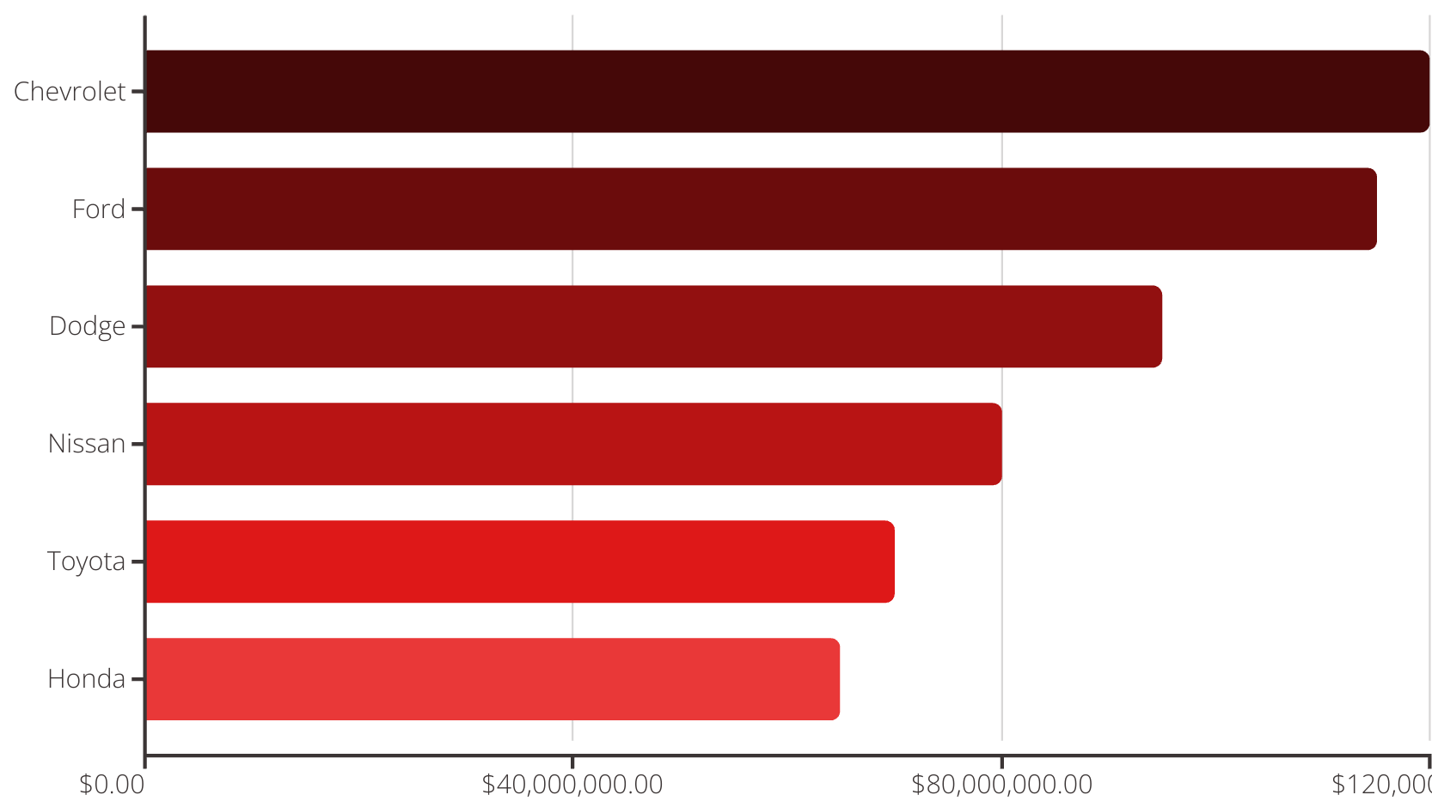
Sales by Company
Analysis of sales by company reveals strong brand performance, with several manufacturers leading the market. Chevrolet, Ford, and Dodge consistently demonstrate high sales volumes, indicating strong consumer preference for these brands. This suggests effective marketing and product offerings from these top performers.

Slide 4
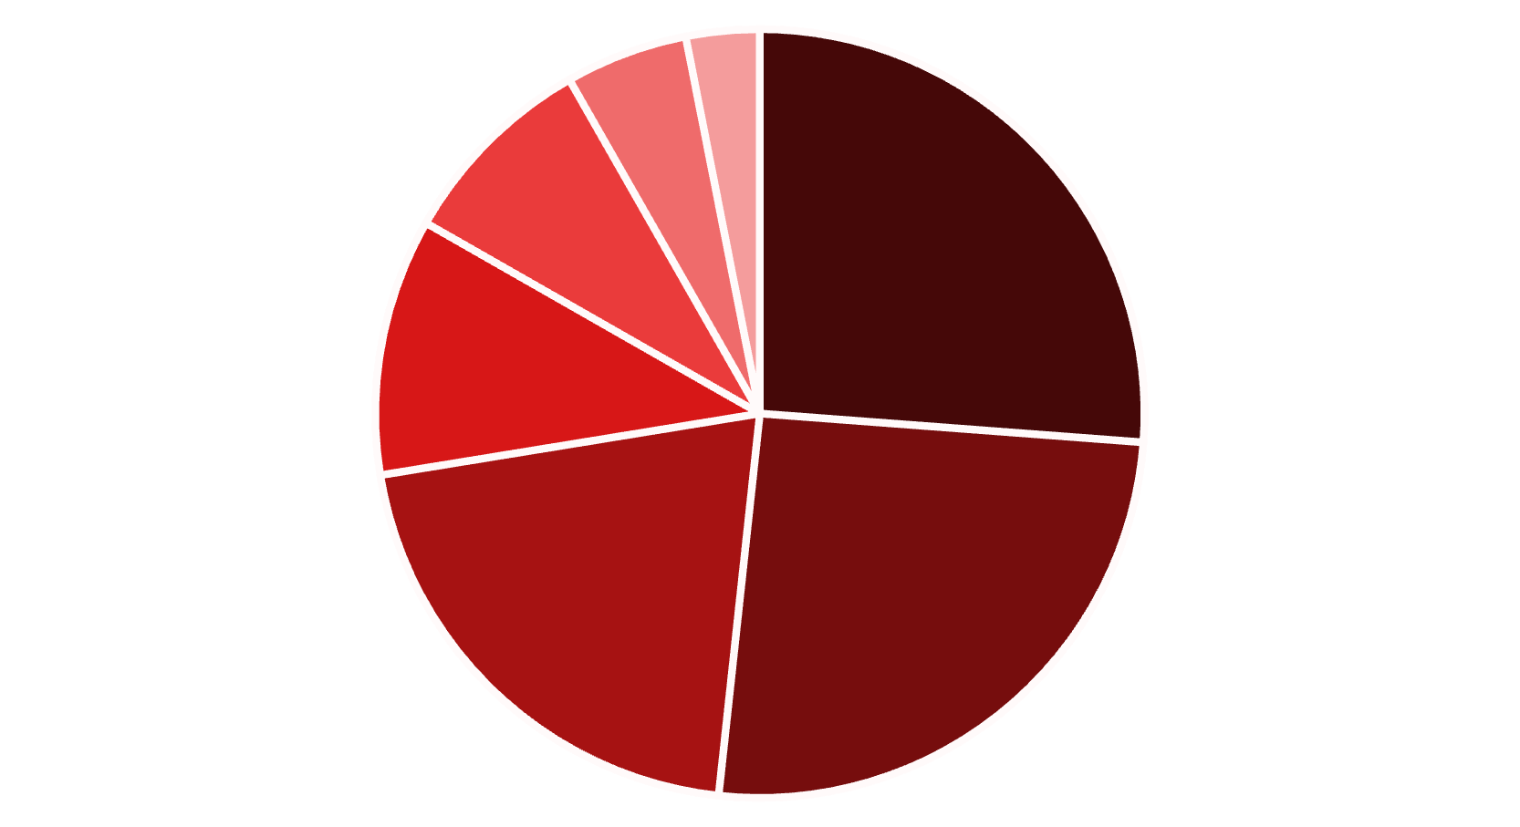
Sales by Body Style
The distribution of sales across different body styles indicates clear consumer preferences. SUVs and Sedans dominate the market, collectively accounting for a significant portion of total sales. This insight is crucial for inventory management and targeted marketing efforts.
SUVs
Sedans
Trucks
Coupes
Hatchbacks
Minivans
Convertibles

Slide 5
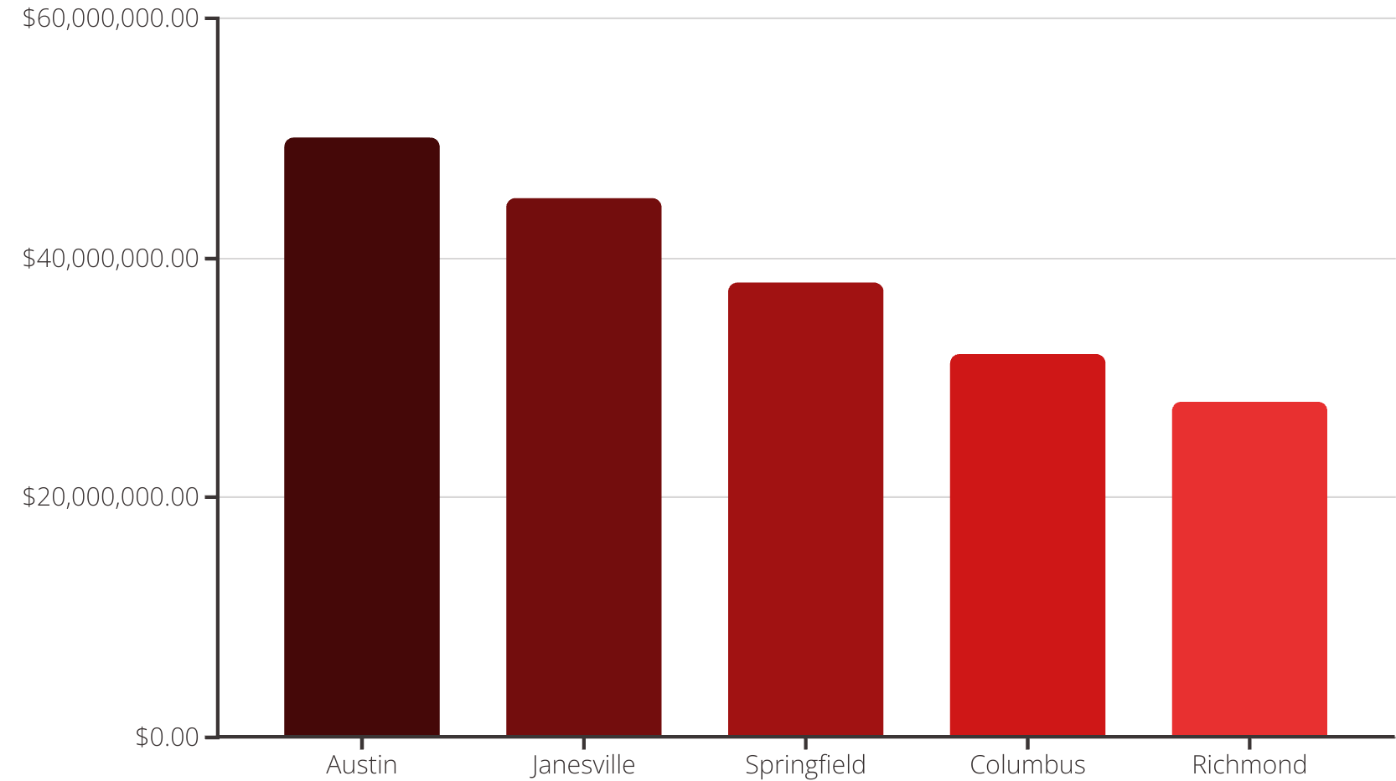
Sales by Dealer Region
Regional sales performance varies significantly, with certain areas demonstrating exceptional market penetration. Austin and Janesville emerged as top-performing dealer regions, contributing substantially to overall sales figures. This suggests localized strengths in sales strategies or market demand that can be leveraged.

Slide 6
Interactive Power BI Dashboard Overview
This dashboard provides a comprehensive visual representation of our car sales data. It allows for interactive exploration of performance metrics, sales trends, and regional insights. Users can drill down into specific data points to gain deeper understanding and support data-driven decision-making.

Slide 7
Conclusion & Recommendations
Our analysis highlights robust sales performance, particularly in SUVs and the Chevrolet brand, with Austin leading regional sales. These areas represent significant strengths and opportunities for continued growth.
To further optimize performance, we recommend:
Explore Sedan Marketing: Investigate strategies to boost sedan sales, potentially through targeted campaigns or new model introductions.
Boost Presence in Underperforming Regions: Identify and address factors limiting sales in lower-performing regions, implementing localized growth initiatives.

